Slide 1
Weekly Meeting 6
Week 6: (03/04/2022)
Team Lead: Preston Robertson
GANS DIS Spring 2022

Slide 2
Objective
To upgrade our thought process on how to evaluate GANs from our original view of 50% accuracy in the discriminator model.
Chapter 9: Generating a Face from the Latent Space
Chapter 10: GAN Failure Modes
Mode Collapse Failure
Convergence Failure
Chapter 11: How to Evaluate GANs
Problem with Evaluating Generator Models
Manual GAN Generator Evaluation
Qualitative GAN Generator Evaluation
Quantitative GAN Generator Evaluation
Which GAN Evaluation Scheme to Use

Slide 3
Recap: Last Week
The last two weeks the topics have been:
Developing a 1D GANS model
Developing a 2D GANS model for images
These chapters focused on the code and application of GANs and applied all the theoretical knowledge from the past weeks.
This Week:
We will start the process again, discussing theoretical for future weeks to discuss the application.

Slide 4
Chapter 9: Generating a Face from the Latent Space
Week 6: (03/04/2022)
Team Lead: Preston Robertson
GANS DIS Spring 2022

Slide 5
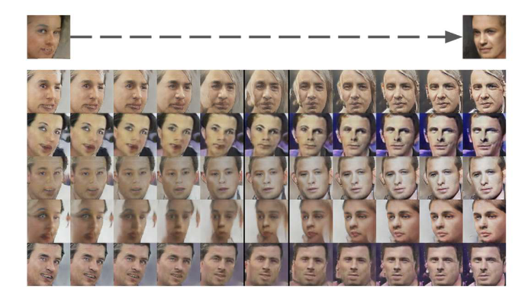
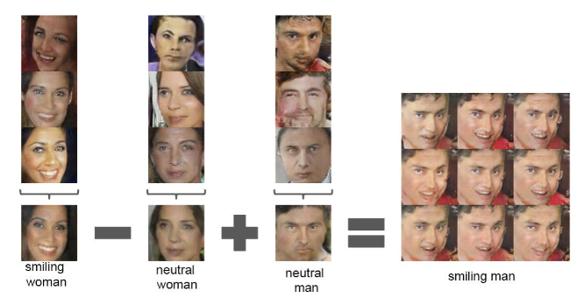
Summarized: Generating a Face from the Latent Space
Taking the information from the last two weeks with Vector Arithmetic in Latent Space. It is possible to generate faces.
For Vector Arithmetic in Latent Space, instead of taking only one point in the latent space, we take multiple points and combine them to generate the synthetic image.
The distance between each point creates a gradient of images, instead of creating just one. This in turn provides an advantage for generating complex images, such as human faces.

Slide 6
Chapter 10: GAN Failure Modes
Week 6: (03/04/2022)
Team Lead: Preston Robertson
GANS DIS Spring 2022

Slide 7
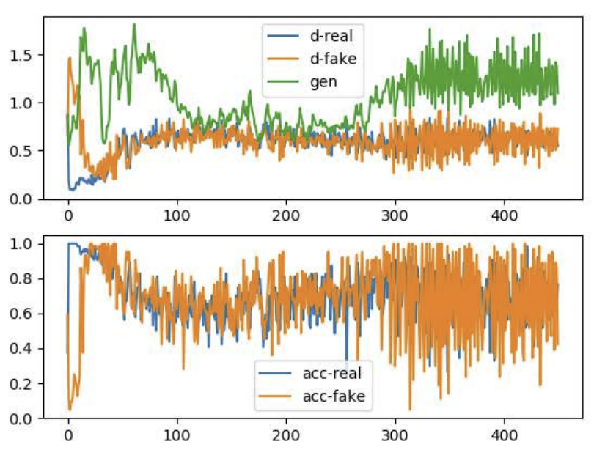
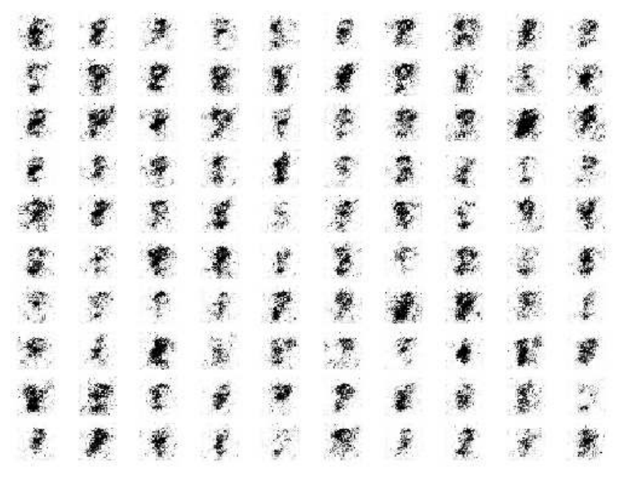
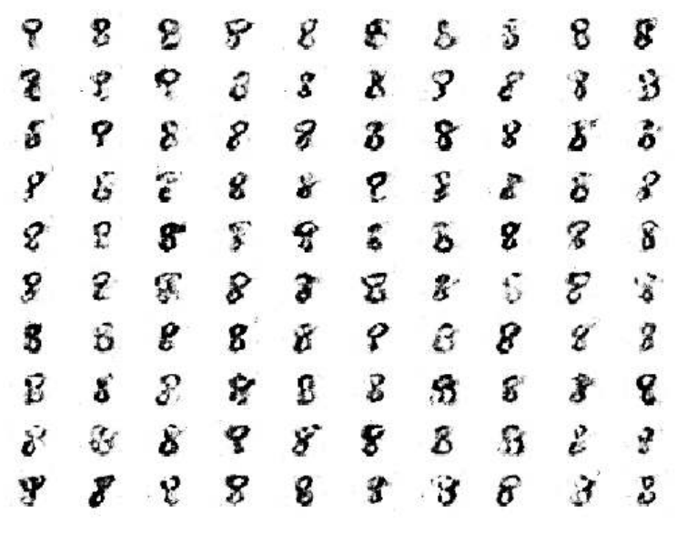
GAN Failure Modes
Stable GANs
Discriminator loss on real and fake images is expected to sit around 0.5.
Generator loss on fake images is expected to sit between 0.5 and perhaps 2.0.
Discriminator accuracy on real and fake images is expected to sit around 80%.
Variance of generator and discriminator loss is expected to remain modest.
Training stability may degenerate into periods of high-variance loss and corresponding lower quality generated images.
Captured at 180 Epochs
Captured at 45 Epochs
General Period Of Stability

Slide 8
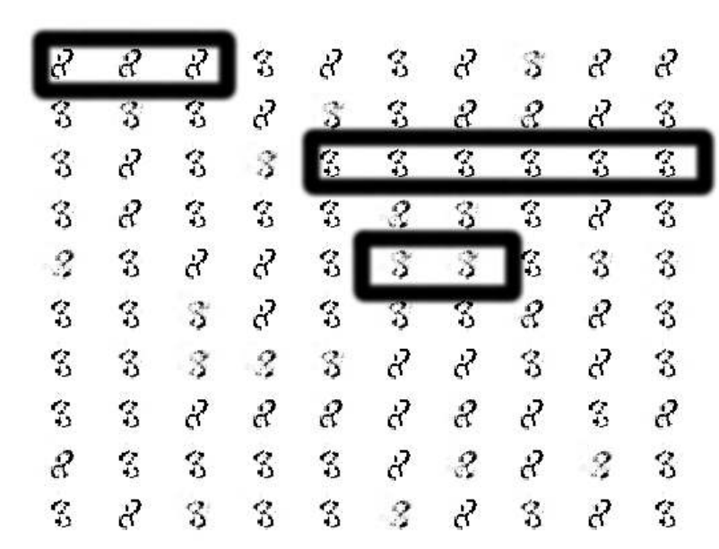
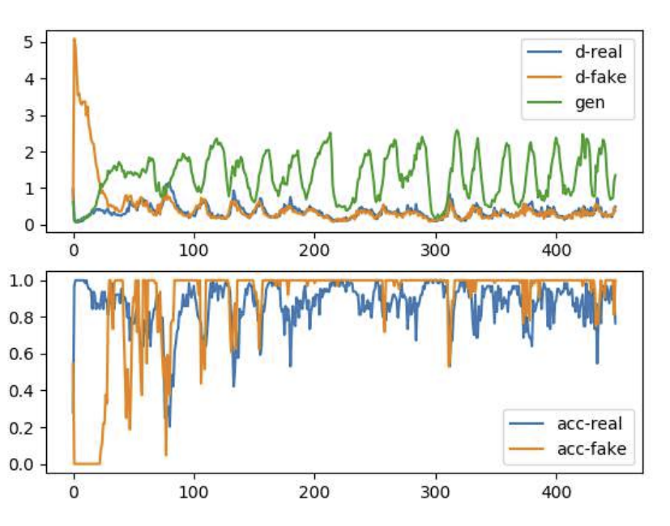
GAN Failure Modes
Mode Collapse
Defined by a generator model that is only able to generate a small subset of different outputs (modes). Modes = output distributions.
This means that from all the points in the latent space, the generator is only able to output a small subset of generated images.
This is the result of the generator learning to map different input, z, values to a single output point.
Identifying Mode Collapse failure:
Evaluate a set of generated images:
Look for low diversity (repeating patterns of the same image)
Plot the Model Loss:
The line plot will show oscillations in the loss overtime
This is most noticeable with the Generator
Loss
Accuracy

Slide 9
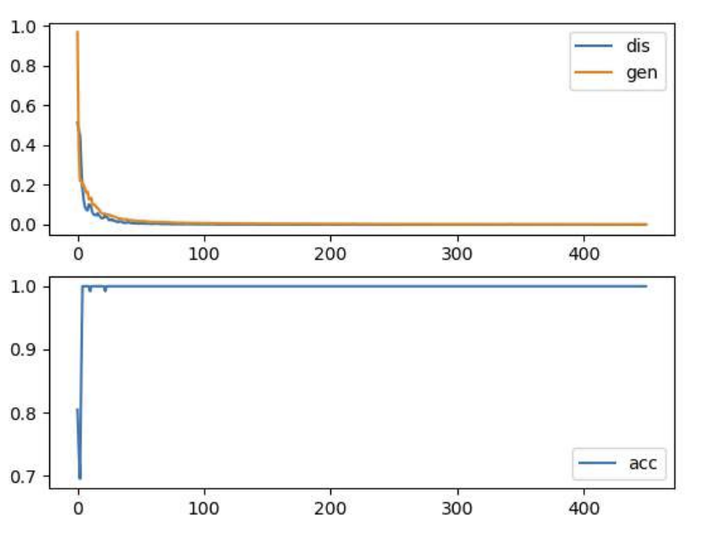
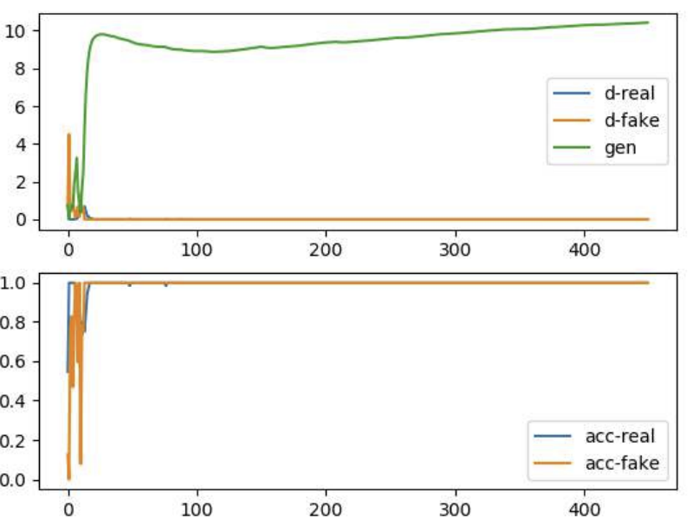
GAN Failure Modes
Convergence Failure
Loss
The most common reason why GANs will fail.
Typically, a neural network fails to converge when the model loss does not settle down during the training process. In the case of a GAN, a failure to converge refers to not finding an equilibrium between the discriminator and the generator.
Identifying Convergence failure:
Loss of Discriminator rapidly falls and stays close to 0 during training
Loss of Generator either decreases to zero, or will continually increase during training
Generator output images are extremely low quality and can be easily identified by the discriminator
Accuracy
Loss
Accuracy

Slide 10
Chapter 11: How to Evaluate GANS
Week 6: (03/04/2022)
Team Lead: Preston Robertson
GANS DIS Spring 2022

Slide 11
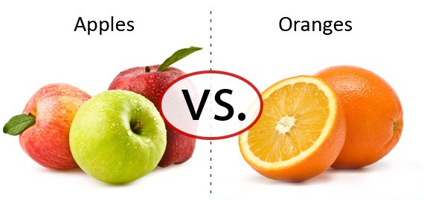
Problem with Evaluating Generator Models
“…there is no generally agreed upon way of evaluating a given GAN generator model.”
- The Book
Most models are evaluated bested on the context of the problem domain.
Issues that arise from not using an evaluation technique include:
Choosing a final version of the generator model during training.
Comparing GAN models will not be possible in both:
GAN model architecture,
And GAN model configurations.

Slide 12
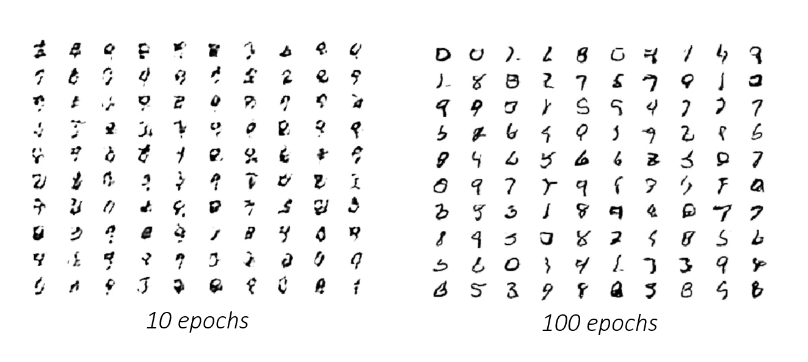
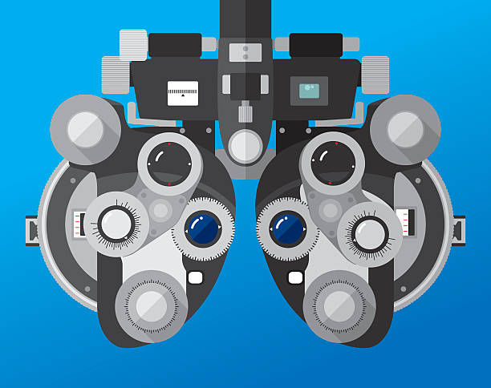
Manual GAN Generator Evaluation
Manual model assessment is the most common for of evaluation and is a good starting point, when it comes to evaluating GANs.
This method requires a researcher to determine the quality and diversity of the images given their respective target domain.
Problems with this method:
It is subjective (in all aspects)
Requires knowledge of target domain
The training speed is limited by the number of images the researcher can review.

Slide 13
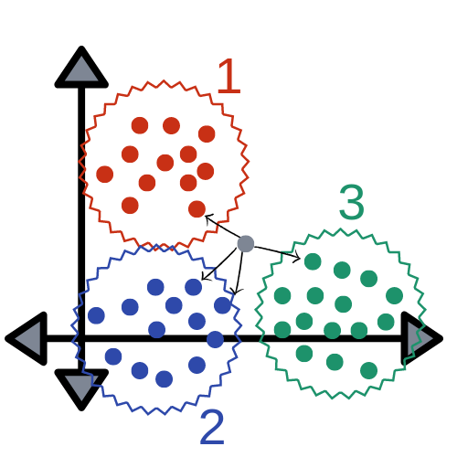
Qualitative GAN Generator Evaluation
These are not numerical evaluations and often still involve subjective evaluations or evaluations through comparison.
Subjective Evaluation:
The Rating and Preference Judgement is a form of manual inspection that hopes to mitigate bias through a set of metrics set based on the target domain.
Evaluation through Comparison:
Nearest Neighbors uses machine learning concepts to group all similar images. The Euclidean distance from the center of the cluster can be used a metric for realism.

Slide 14
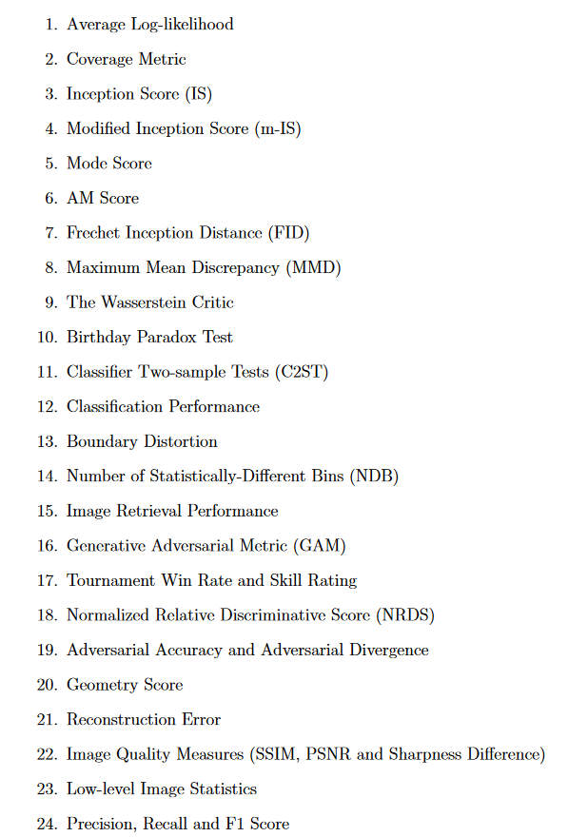
Quantitative GAN Generator Evaluation
The methods include using calculations to set a specific numerical score to judge the image.
The books gives this list of possible evaluation methods.
Most of these methods use kernel or density estimation from the real images to determine the realness of the generated images.
“Inception Score (IS) [...] is perhaps the most widely adopted score for GAN evaluation.”
- Pros and Cons of GAN Evaluation Measures, 2018

Slide 15
Which GAN Evaluation Scheme to Use
What are the best methods to use for GAN Evaluation?
Manual Image Inspection
Rating and Preference Judgement
Nearest Neighbors
Inception Score
Fréchet Inception Distance
This was determined through the amount of people who use these methods.
This list is in order from easiest to hardest implement initially.

